Slide 1
Quest for a Quantum Search Algorithm for Testing Stuck-at Faults in Digital Circuits
Murali Venkatasubramanian Vishwani D. Agrawal
Ph.D. Candidate James J. Danaher Professor
Department of Electrical and Computer Engineering
Auburn University

Slide 2
Outline
Purpose
Background
Methodology
Simulation setup
Results
Future work
Conclusion
DFT 2015

Slide 3
Purpose
Given a stuck-at fault, find a test.
Specifically, finding tests for hard to detect stuck-at faults.
Improve the bottleneck of finding the unique tests.
Rephrase the VLSI Testing problem as a database search problem.
Practical implementation of Grover’s quantum search algorithm to target difficult to detect faults.

Slide 4
Background

Slide 5
Overview of Previous Research
Fault detection problem is NP complete [Ibarra and Sahni, 1975; Fujiwara and Toida, 1982; Seroussi and Bshouty, 1988].
Increase in circuit size and complexity increases computation time.
Nature of NP problem.
Generation of test vectors a classic VLSI problem.
Tackled by numerous algorithms.

Slide 6
Overview (contd..)
Deterministic algorithms derived from structural description of circuits.
D Algorithm [Roth, 1966].
PODEM [Goel, 1981].
FAN [Fujiwara and Shimono, 1983].
And various others...
Test sets derived from functional description of circuits [Akers, 1972; Reddy, 1973].
Use of weighted random test generators.
Heuristics like input switching activity and weight assignment [Schnurmann et al., 1972].
Skewing input probabiltiy to attain maximum output entropy [Agrawal, 1981].
Adaptive Test generation
Genetic algorithms [Shafer and Morishma, 1987; Srinivas and Patnaik, 1994].
Anti-random test generators [Malaiya, 1995].
Using spectral properties of successful tests to generate new test vectors [Yogi and Agrawal, 2006].
Search limits when searching for unique test vectors of hard to detect faults.
Problem devolves back to NP hard problem.

Slide 7
Overview (contd..)
Growing interest in quantum computing leading to revisiting of NP hard problems.
Find optimal solutions in linear time.
A n primary input (PI) circuit can have N = 2^{n} possible test vector combinations.
A test can be found from among these N vectors.
Hence, VLSI testing problem can rephrased as an unsorted database search problem of N elements.
In our best interest to implement one of the fastest unsorted database search algorithms to find test vectors.
Grover's quantum search algorithm [Grover, 1996] can search through an unsorted database in sub-linear time.
Deemed the fastest way to search an unsorted database theoretically [Bennett el al., 1997].

Slide 8
Grover's Quantum Algorithm
Finds the element in an unsorted database which can satisfy a particular function.
Uses an "Oracle" to iteratively search for the qubits representing the element to be searched.
Idea of “Oracle” key behind implementation of Grover’s quantum search algorithm.
Can recognize the solution to a database search without knowing the actual solution.
Distinction between “knowing” the solution and “recognizing” the solution [Nielsen and Chuang, 2011].
Possible to do the latter without knowing the former.

Slide 9
Overview (contd..)
Nature of quantum computing implies no information loss.
Contemporary algorithms ignore failed test vectors and only use previous successes.
Proposed algorithm utilizes both successful and failed test vectors.
Moving away from failed vectors will lead to solution in quicker iterations.
Proposed algorithm contains the essence of Grover’s quantum search algorithm.

Slide 10
Methodology

Slide 11
Conceptual Outline
Main conjecture is to avoid all vectors with properties similar to known failed test vectors.
The direction of search gets skewed towards the correct test vector.
Test vectors in the vector space are classified into three categories:
Activation vectors
Propagation vectors
Failed vectors

Slide 12
Outline (contd..)

Slide 13
Algorithm Implementation
Initialize weighted probabilities of all PIs being bit "1" to 0.5 and extract a vector.
Add test vector to the failed vector list and recalculate weighted probabilities of all PIs.
Invert the weighted probability and extract a bit value from the new calculated probability.
Operation performed till an activation/propagation vector is extracted.

Slide 14
Implementation (contd..)
Derive new vectors using weights which extracted previous activation/propagation vector.
Tweak the weights in smaller increments utilizing the failed vector weights for direction.
Idea is move towards the intersection of activation/propagation vectors when inside "region of desirability".
Avoid going back to failed vector region.

Slide 15
Algorithm: A Working Example
Initial Probability values for proposed algorithm
Initial probability values for random search

Slide 16
After 5 Iterations..
Probability values for proposed algorithm
Probability values for random search

Slide 17
After 10 Iterations..
Probability values for proposed algorithm
Probability values for random search

Slide 18
After 15 Iterations..
Probability values for proposed algorithm
Probability values for random search

Slide 19
Simulation Setup

Slide 20
Tools Used
MATLAB from MathWorks used to code the proposed algorithm.
Test vectors extracted from MATLAB were sent to Mentor’s FastScan to verify if they can test the fault.
FastScan’s random pattern generator used to emulate a random search for test vectors.

Slide 21
Results

Slide 22
Example Circuit
The given circuit has a stuck-at-1 fault on a line.
Fault site has:
One successful test.
Eight activation vectors.
Four propagation vectors.
Performed 100 trial runs on the faulty circuit.

Slide 23
Example Circuit Results
Distribution of number of iterations needed to search for the correct test vector (#PIs = 6).

Slide 24
ALU Control Circuit
Distribution of number of iterations needed to search for the correct test vector (#PIs = 7).

Slide 25
Comparing Average Iterations
Circuit | Search space size, N = 2^{#PI} | Grover’s quantum search (√N) | Proposed algorithm | Random search (~ N/2)
Test circuit (#PI = 6) | 64 | 8 | 14 | 34
ALU control (#PI = 7) | 128 | 11 | 15 | 62
Decoder (#PI = 8) | 256 | 16 | 24 | 133
C6288 (#PI = 32) | 4.30×10⁹ | 65,536 | 74,352 | 2.42×10⁹

Slide 26
Future Work
Optimizing the algorithm for more efficiency.
Try different methods of implementation e.g. probability correlation between test vectors.
Running simulations on all ISCAS benchmark circuits.
Comparing efficiency with other contemporary and deterministic algorithms to prove superiority.

Slide 27
Conclusion
Demonstrated proof of concept of new probabilistic correlation algorithm.
Initial results show the superiority of algorithm over random search for hard to detect stuck-at faults.
First attempt to emulate the mathematical model of Grover’s algorithm in a more practical manner.
Promises of better and more efficient implementations underway.

Slide 28
References
[1] O. H. Ibarra and S. Sahni, “Polynomially complete fault detection problems,” IEEE Trans. Computers, vol. 24, no. 3, pp. 242–249, 1975.
[2] H. Fujiwara and S. Toida, “The complexity of fault detection problems for combinational logic circuits,” IEEE Transactions on Computers, vol. 100, no. 6, pp. 555–560, 1982.
[3] G. Seroussi and N. H. Bshouty, “Vector sets for exhaustive testing of logic circuits,” IEEE Transactions on Information Theory, vol. 34, no. 3, pp. 513–522, 1988.
[4] J. P. Roth, “Diagnosis of automata failures: A calculus and a method,” IBM Journal of Research and Development, vol. 10, no. 4, pp. 278–291, 1966.
[5] P. Goel, “An implicit enumeration algorithm to generate tests for combinational logic circuits,” IEEE Transactions on Computers, vol. 100, no. 3, pp. 215–222, 1981.
[6] H. Fujiwara and T. Shimono, “On the acceleration of test generation algorithms,” IEEE Transactions on Computers, vol. 100, no. 12, pp. 1137–1144, 1983.
[7] S. B. Akers, “Universal test sets for logic networks,” IEEE Conference Record of 13th Annual Symposium on Switching and Automata Theory, 1972, pp. 177–184.

Slide 29
References (contd..)
[8] S. M. Reddy, “Complete test sets for logic functions,” IEEE Transactions on Computers, vol. 100, no. 11, pp. 1016–1020, 1973.
[9] H. D. Schnurmann, E. Lindbloom, and R. G. Carpenter, “The weighted random test-pattern generator,” IEEE Transactions on Computers, vol. 100, no. 7, pp. 695–700, 1975.
[10] V. D. Agrawal, “An information theoretic approach to digital fault testing,” IEEE Transactions on Computers, vol. 30, no. 8, pp. 582–587, 1981.
[11] N. Yogi and V. D. Agrawal, “Spectral RTL test generation for gate-level stuck-at faults,” Proc. 15th IEEE Asian Test Symposium, 2006, pp. 83–88.
[12] L. K. Grover, “A Fast Quantum Mechanical Algorithm for Database Search,” in Proc. 28th Annual ACM Symposium on Theory of Computing, 1996, pp. 212–219.
[13] C. H. Bennett, E. Bernstein, G. Brassard, and U. Vazirani, “Strengths and Weaknesses of Quantum Computing,” SIAM Journal on Computing, vol. 26, no. 5, pp. 1510–1523, 1997.
[14] M. A. Nielsen and I. L. Chuang, Quantum Computation and Quantum Information. New York: Cambridge University Press, 10th edition, 2011. [15] Y. K. Malaiya, “Antirandom testing: Getting the most out of black-box testing,” Proc. Sixth IEEE International Symposium on Software Reliability Engineering, 1995, pp. 86–95.

Slide 30
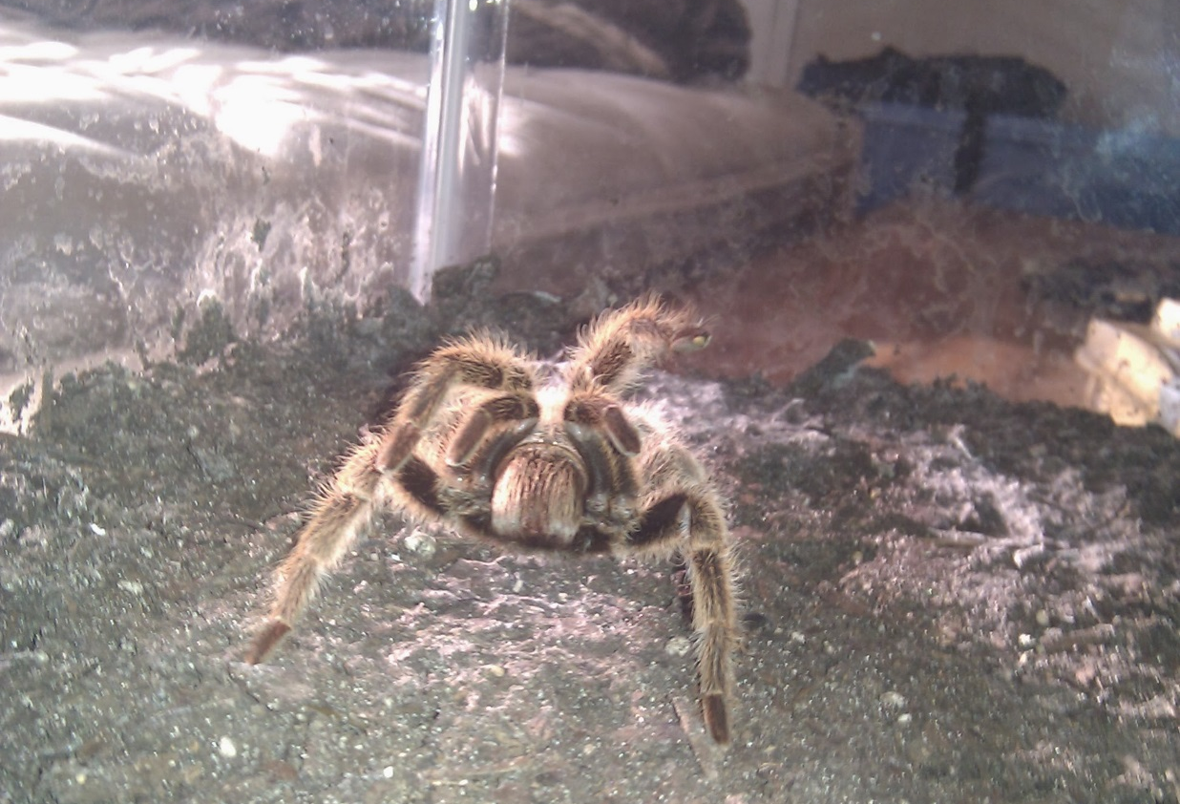
Questions??
Thank You!!!

